Slide 1
ANGULAR

Slide 2

1. Components
What is a Component?
An Angular Component is the smallest and most important building block of an application. It controls a specific part of the user interface (UI).
Every component is made up of three parts:
HTML Template → Defines the UI layout
TypeScript Class → Contains logic, data, and methods
CSS / SCSS → Styling for the component
• Components help build reusable, modular, and
maintainable code.
• Every Angular app has at least one
component: AppComponent.

Slide 3
2. Component Structure
A component is created using
the @Component decorator which provides metadata
like selector, template, and styles.
Usage in HTML:
<app-example></app-example>
Example:
@Component({
selector: 'app-example', // HTML tag for this component
templateUrl: './example.component.html', // Template file
styleUrls: ['./example.component.css'] // Styles
})
export class ExampleComponent {
title = 'Hello Angular';
message = 'This is a sample component!';
showMessage() {
alert(this.message); } }

Slide 4
3. Creating Components with Angular CLI
1. Create a Basic Component
ng generate component component-name
// or shorthand:
ng g c component-name
2. Create a Component Inside a Folder
ng g c user/profile // creates: user/profile component
3. Create a Standalone Component (Angular 15+)
Standalone components remove the need for
NgModules.
ng g c dashboard --standalone

Slide 5
4.Component File Breakdown
FILE | DESCRIPTION
example.component.ts | Contains the class and logic of the component.
example.component.html | Defines the UI structure (template).
example.component.css | Contains component- specific styling.
example.component.spec.ts | Test file (unit testing) — optional for beginners.

Slide 6
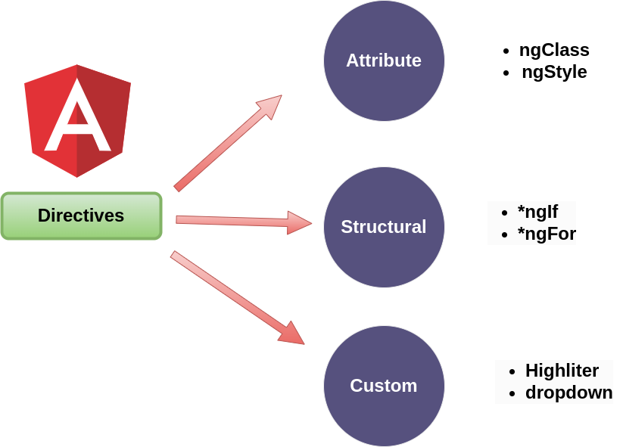
5. Directives
What are Directives?
Directives are special instructions in Angular that allow
you to change the structure, appearance, or behavior of
DOM elements.
• They act like **custom HTML attributes or tags**.
• They help modify the DOM dynamically.
• They are one of Angular’s core features for
building interactive UIs.

Slide 7
6. Types of Directives
DIRECTIVE TYPE | PURPOSE | EXAMPLE
Component Directive | Directives with templates (most Commonly used). | <app-user>
Structural Directive | Modify DOM structure by adding/removing elements. | *ngIf, *ngFor, *ngSwitch
Attribute Directive | Modify the appearance or behavior of elements. | ngClass, ngStyle

Slide 8
Angular Interview Questions
1. What is a Component in Angular?
Answer: A Component is the smallest and most important building block of an Angular application. It controls a specific part of the User Interface (UI). Every Angular application contains at least one component called AppComponent.
2. Why are Components used?
Answer: Components are used to:
Build reusable UI
Organize code into smaller modules
Improve maintainability
Separate UI, logic, and styling

Slide 9
Angular Interview Questions
3. What are the three parts of a Component?
Answer:
Every component has three main parts:
HTML Template
Defines the UI layout.
TypeScript Class
Contains data, properties, methods, and business logic.
CSS/SCSS
Defines the styles for the component.
4. Which component is mandatory in every Angular application?
Answer:
Every Angular application must have at least one component called AppComponent.
5. What is the purpose of the @Component decorator?
Answer:
The @Component decorator is used to define a component and provide metadata such as:
selector – Custom HTML tag for the component.
templateUrl – Path to the HTML template.
styleUrls – Path to the CSS/SCSS file.

Slide 10
Angular Components Interview Questions
6. Explain the files created for an Angular Component.
Answer:
example.component.ts – Contains the component's logic.
example.component.html – Contains the UI/template.
example.component.css – Contains component-specific styling.
example.component.spec.ts – Used for unit testing.
7. What are Directives in Angular?
Answer:
Directives are special instructions in Angular that modify the structure, appearance, or behavior of DOM elements. They act like custom HTML attributes or tags and help build interactive user interfaces.
8. What are the different types of Directives in Angular?
Answer: There are three types of directives:
Component Directive – A directive with its own template (e.g., <app-user>).
Structural Directive – Modifies the DOM by adding or removing elements (e.g., *ngIf, *ngFor, *ngSwitch).
Attribute Directive – Changes the appearance or behavior of elements (e.g., ngClass, ngStyle).

Slide 11
8.Task
Task 2: Practice Structural Directives
Create a component named directives-demo.
Requirements:
Use *ngIf to display:
"Angular is Awesome!“
Use *ngFor to display the following programming languages:
Java
Python
JavaScript
Angular
Use *ngSwitch to display different messages for:
Student
Teacher
Admin
Task 1: Create a Component
Objective: Create a component named student.
Requirements:
Create the component using Angular CLI.
Display the following information:
Student Name
Course
Department
Add simple CSS styling.

